Slide 1

Skylines
The project of Airlines Booking system using PHP and MySql

Slide 2

Modules
1. Admin Login Module
Allows the administrator to securely log in using credentials to manage airline-related operations.
2. Airline Company Login Module
Enables airline companies to log in and access their specific flight and seat booking details.
3. Customer Login & Registration Module
Handles user registration and login. Includes validation, session control, and redirection to the customer dashboard.
4. Flight Management Module (Admin)
The admin can add, update, or delete flights. Admins define source, destination, time, date, available seats, price, airline company, and flight class.
5. Airport Management Module (Admin)
Admin can manage airport data (add/edit/delete). This ensures that the list of airports stays updated and relevant.
6. Airline Company Management Module (Admin)
The admin can register new airline companies with their logo and login credentials. Logos are stored in the system and linked to flight entries.
7. Flight Search Module (Customer)
Customers can view available flights with filters based on source, destination, date, and class. Real-time seat availability is shown.
8. Seat Booking Module (Customer)
Customers select the number of passengers and seat preferences (Window, Aisle, Middle). The system automatically assigns seat numbers accordingly, attempting to
allocate adjacent seats if possible.
9. Passenger Details Module
After selecting seats, customers enter passenger information such as name, age, and gender. The system stores these details along with booking data.
10. Payment Module
Customers can choose a payment method (Card/UPI). After payment confirmation, the booking is marked as "Paid" and stored in the payment history.

Slide 3
Modules
11. Ticket Generation and Download Module
After a successful booking, the system generates a modern flight ticket in PDF format, which includes:
Passenger details
Flight details
Auto-assigned seat numbers
Seat preferences
Airline logo and barcode (design only)
12. Booking History Module (Customer)
Customers can view all their past and current flight bookings, including flight details, price, date, and downloadable ticket links.
13. Booking Overview Module (Airline)
Logged-in airline companies can view the list of passengers booked for each of their flights, including seat numbers and passenger names.

Slide 4

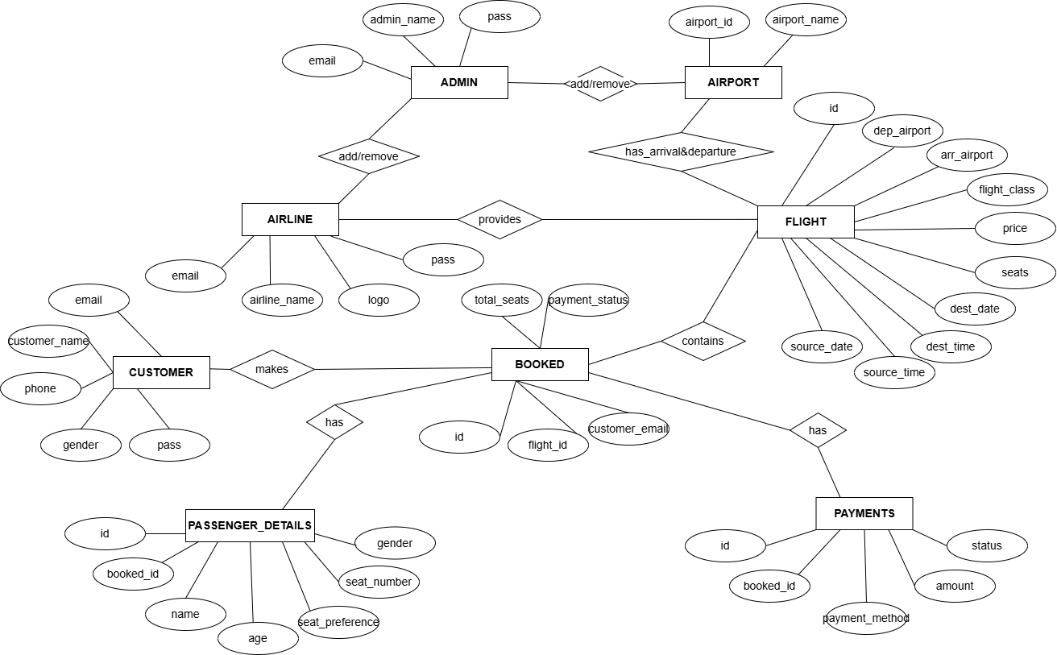
ER Diagrams

Slide 5
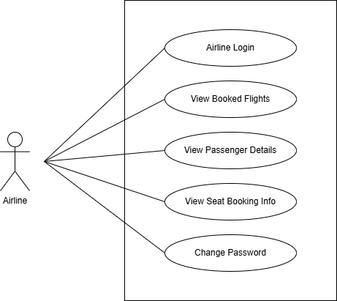
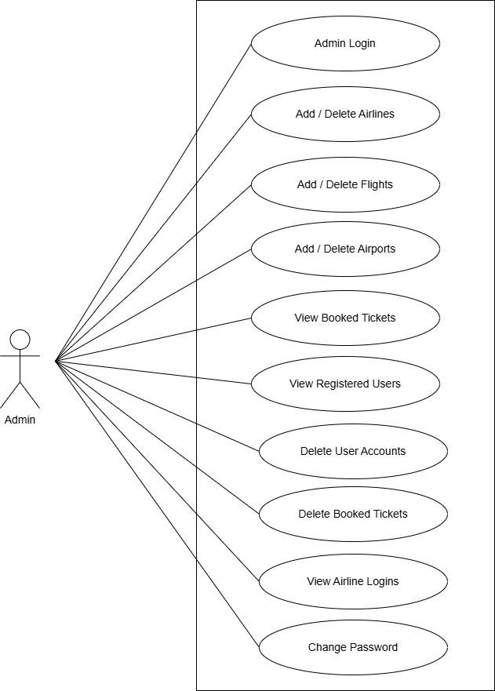
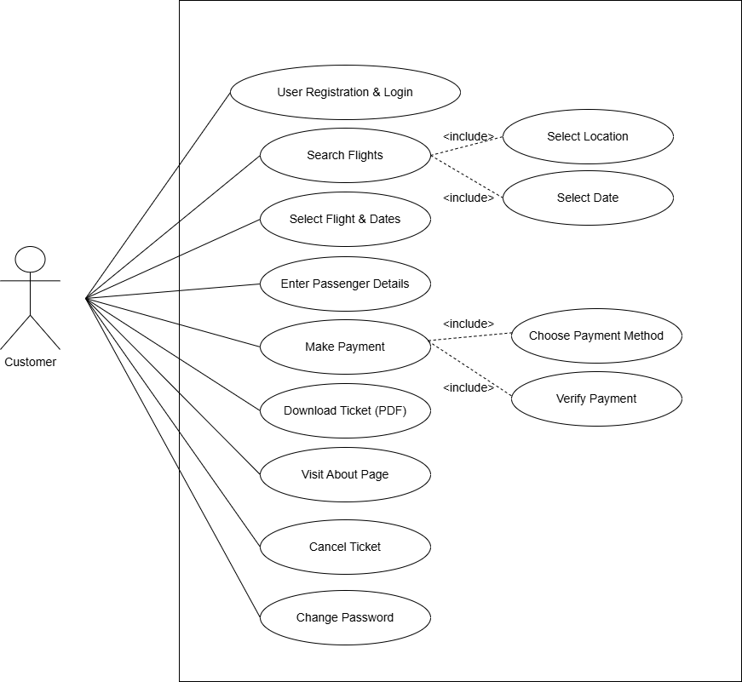
Use Case Diagram

Slide 6
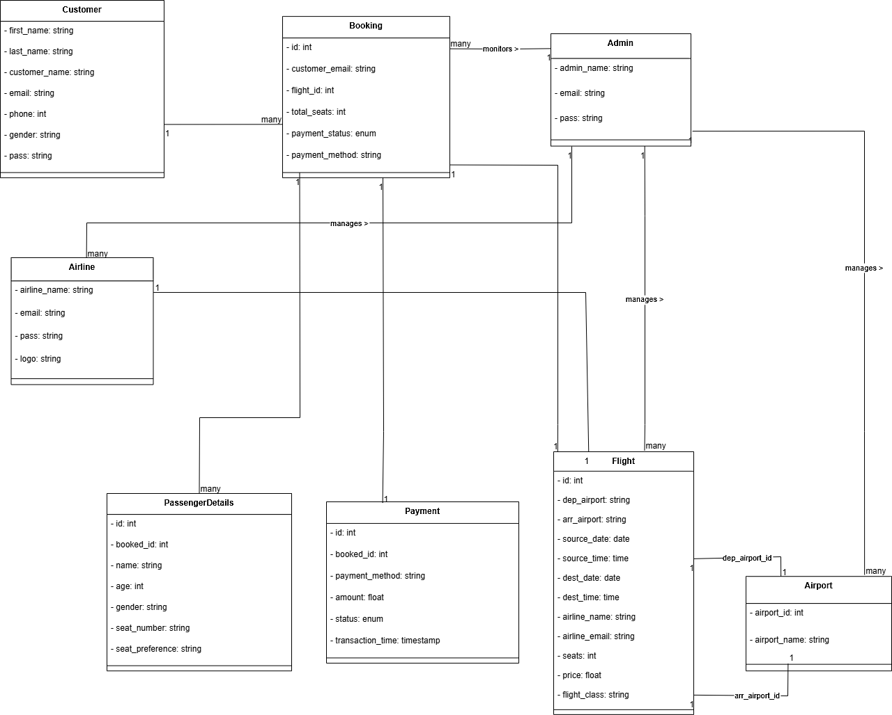
Class Diagrams

Slide 7
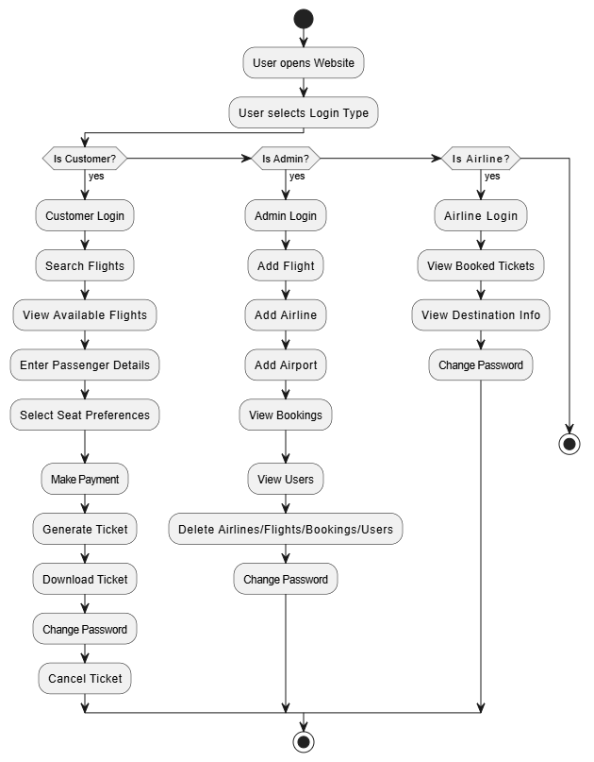
Activity Diagrams

Slide 8
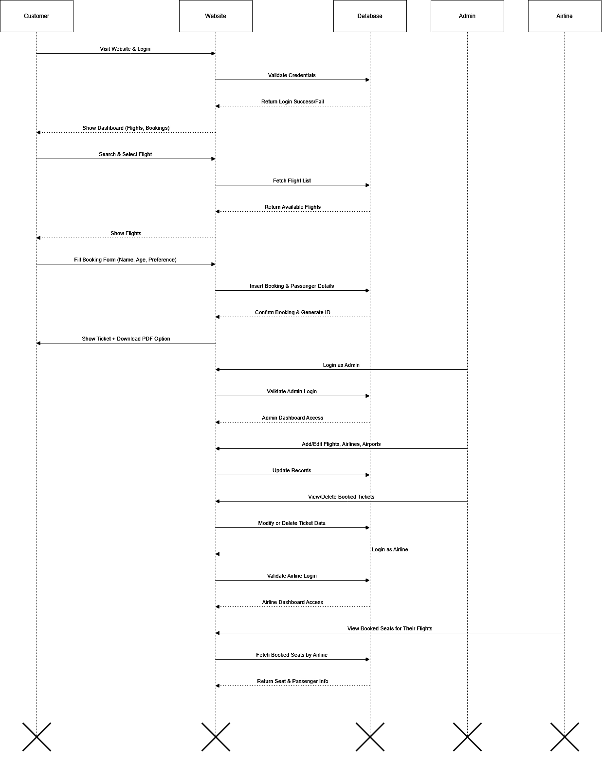
Sequence Diagrams

Slide 9
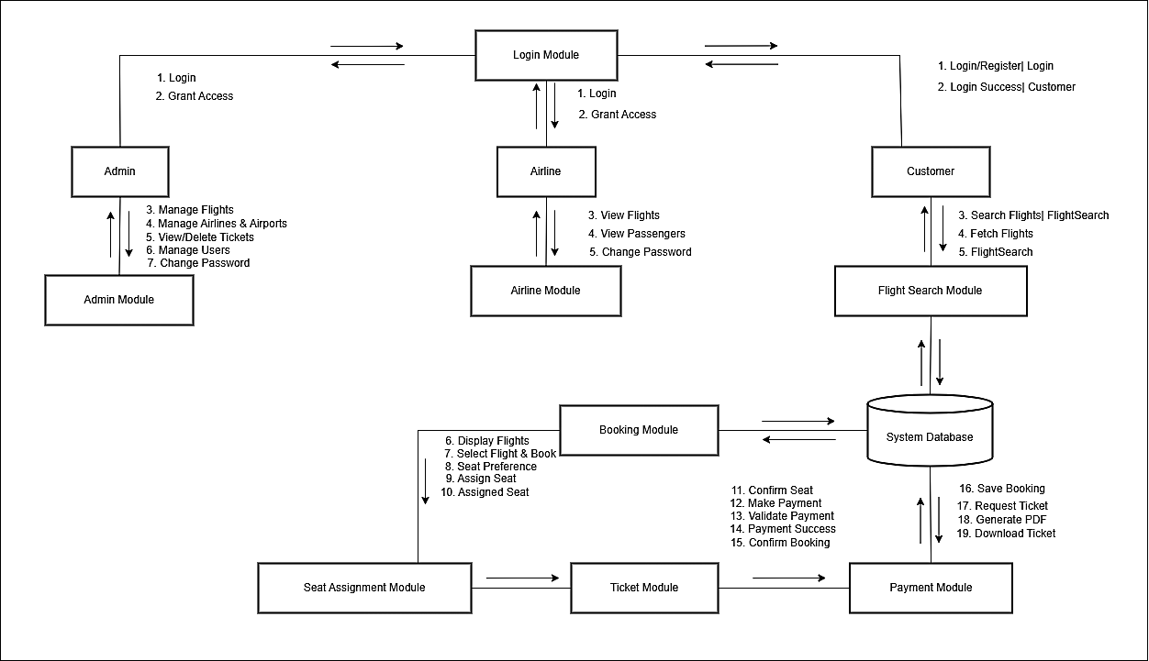
Collaboration Diagrams

Slide 10

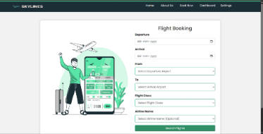
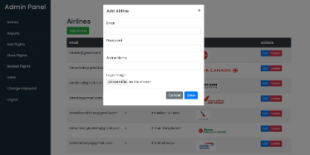
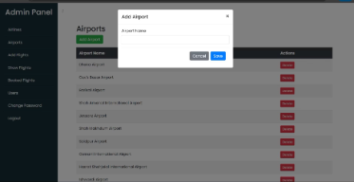
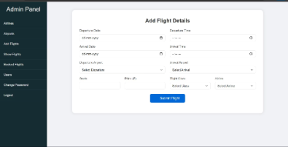
Project Overview
Booking Panel
Add Airlines Panel
Add Airports Panel
Add Flights Panel
Customers can book tickets from here and also can grab their booked ticket with schedules seamlessly.
In this page admin can add airlines in this panels and can fetch details while login in Airlines panel to.
In this panel airports can be added international and domestic too .
In this panel we can add flights with destinations and can be fetched in customer panels where customer can fetch this details and book flights.

Slide 11
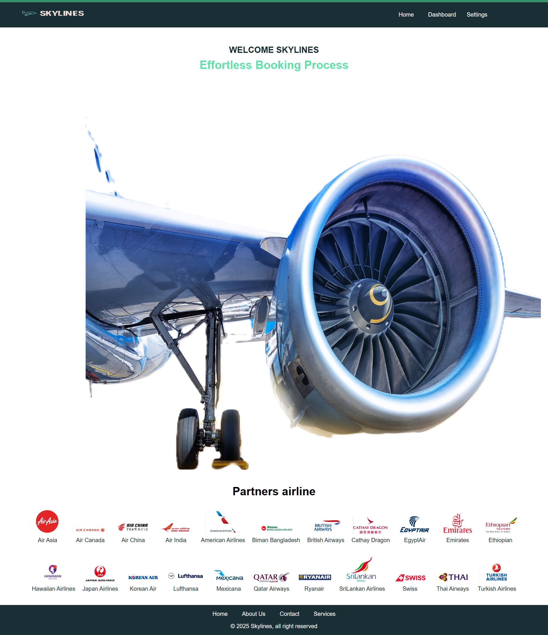
Skylines Airline Booking Website Overview
The Skylines Airline Booking Website is a user-centric platform designed to streamline flight bookings for passengers, airlines, and administrators. It offers a clean, modern interface with dedicated login panels for customers, airlines, and admins, enabling flight search, booking, monitoring, and management.
Built with PHP, MySQL, HTML, CSS, and JavaScript, it features real-time seat allocation, downloadable PDF tickets, and centralized control to enhance operational efficiency and user experience.

